Slide 1
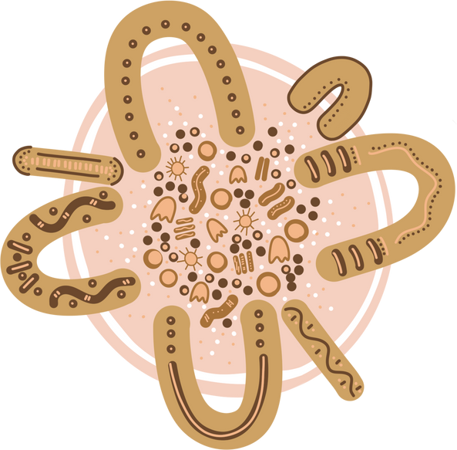
INDG6002 Health and Indigenous Australian Peoples
Social and Cultural Determinants of Health
Week 3 Tutorial:

Slide 2
Warning
This presentation may include images, voices, stories, and names of deceased people now resting in the Dreaming that may cause sadness or distress to Aboriginal and Torres Strait Islander students.

Slide 3
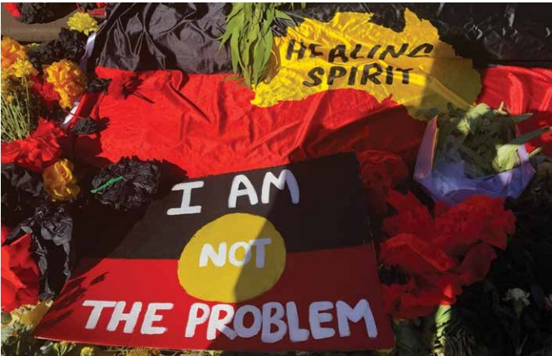
Themes
Cultural and Social determinants of health
Strengths-based approaches
Institutional / systemic racism

Slide 4
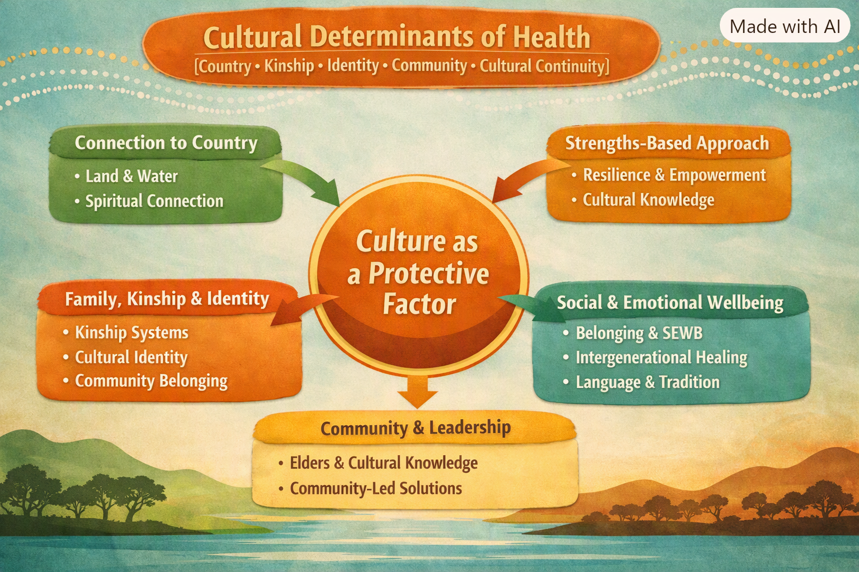
Mapping Module to grass-roots, community-led Indigenous frameworks and approaches
The National Aboriginal and Torres Strait Islander Health Plan 2021–2031

Slide 5
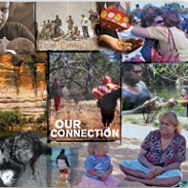

What is culture
Is a ‘learned’ set of:
Beliefs
Practices
Philosophies
Traditions
Set of principles
Values, and Norms that describe a groups particular way of living …their template or pattern for living as a group

Slide 6
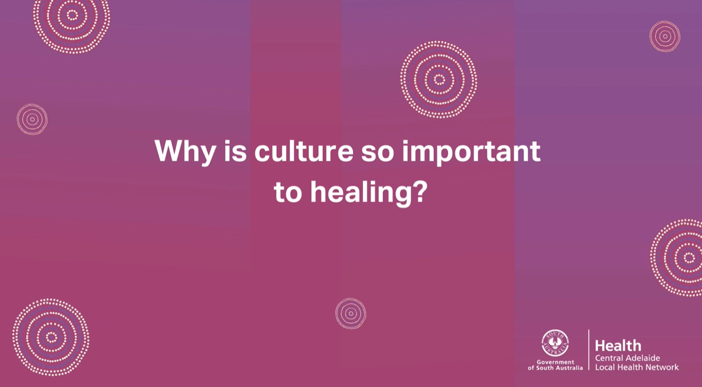
https://www.youtube.com/watch?v=OByUX1o6puU

Slide 7

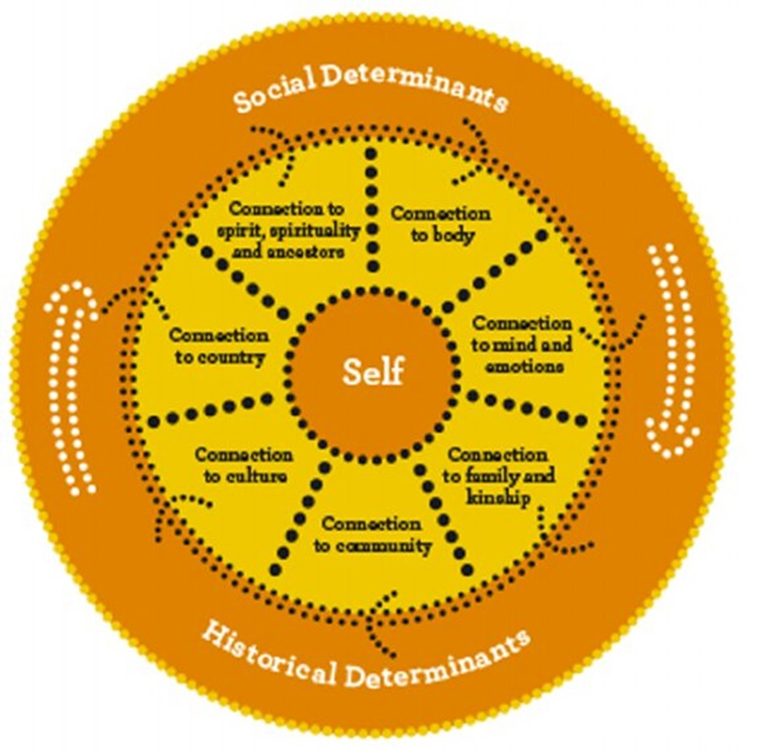
Cultural Determinants of Health
“Cultural Determinants originate from and promote a strength-based perspective, acknowledging that stronger connections to culture and Country build stronger individual and collective identities, a sense of self-esteem, resilience, and improved outcomes across the other determinants of health including education, economic stability and community safety.”
Prof. Ngiare Brown (undated), cited in The Lowitja Institute – Cultural Determinants Roundtable, Melbourne 26th November 2014,
Image: Gee, Dudgeon, Schultz, Hart & Kelly 2014 – Ch 4 – p. 57

Slide 8
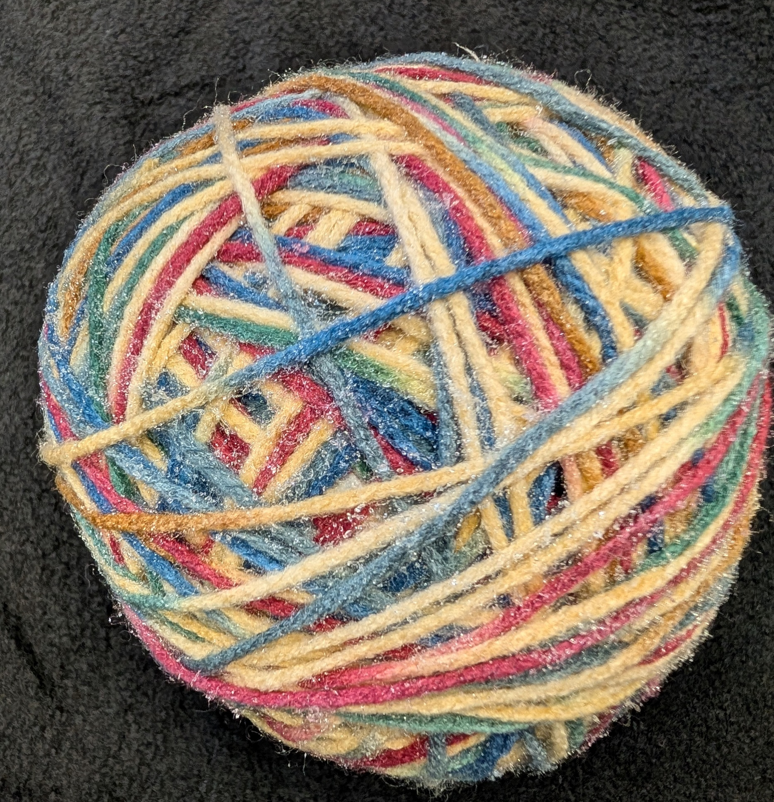
Cultural Determinants of health
… are the protective factors that support good health, wellbeing , and resilience for Aboriginal & Torres Strait Islander peoples, including:
Connection to Country
Connection to Community
Identity
Kinship
Knowledge and Beliefs
Language
Self-determination
Cultural expression
Gee et al, 2014 – Ch 4 – pp. 57-61

Slide 9

Aboriginal and Torres Strait Islander Health Status
“Focusing less on the deficit narratives promoted by the way these indicators are framed and more on the positive affirming impacts of cultural determinants, the narrative can shift more towards strengths based understandings of Aboriginal and Torres Strait Islander health.” p.12
https://healthinfonet.ecu.edu.au/learn/health-facts/overview-aboriginal-torres-strait-islander-health-status/

Slide 10
Re-cap (Module 1):
Strengths-based approaches
Strength and cultural determinants of health
Strength through protective factors
Asset-based approaches and resilience
Strength through decolonisation
Strength as empowerment
Strength as ‘Wholistic health and cultural appropriateness’
Strengths-based counselling approaches
Strength, wellness, and wellbeing

Slide 11
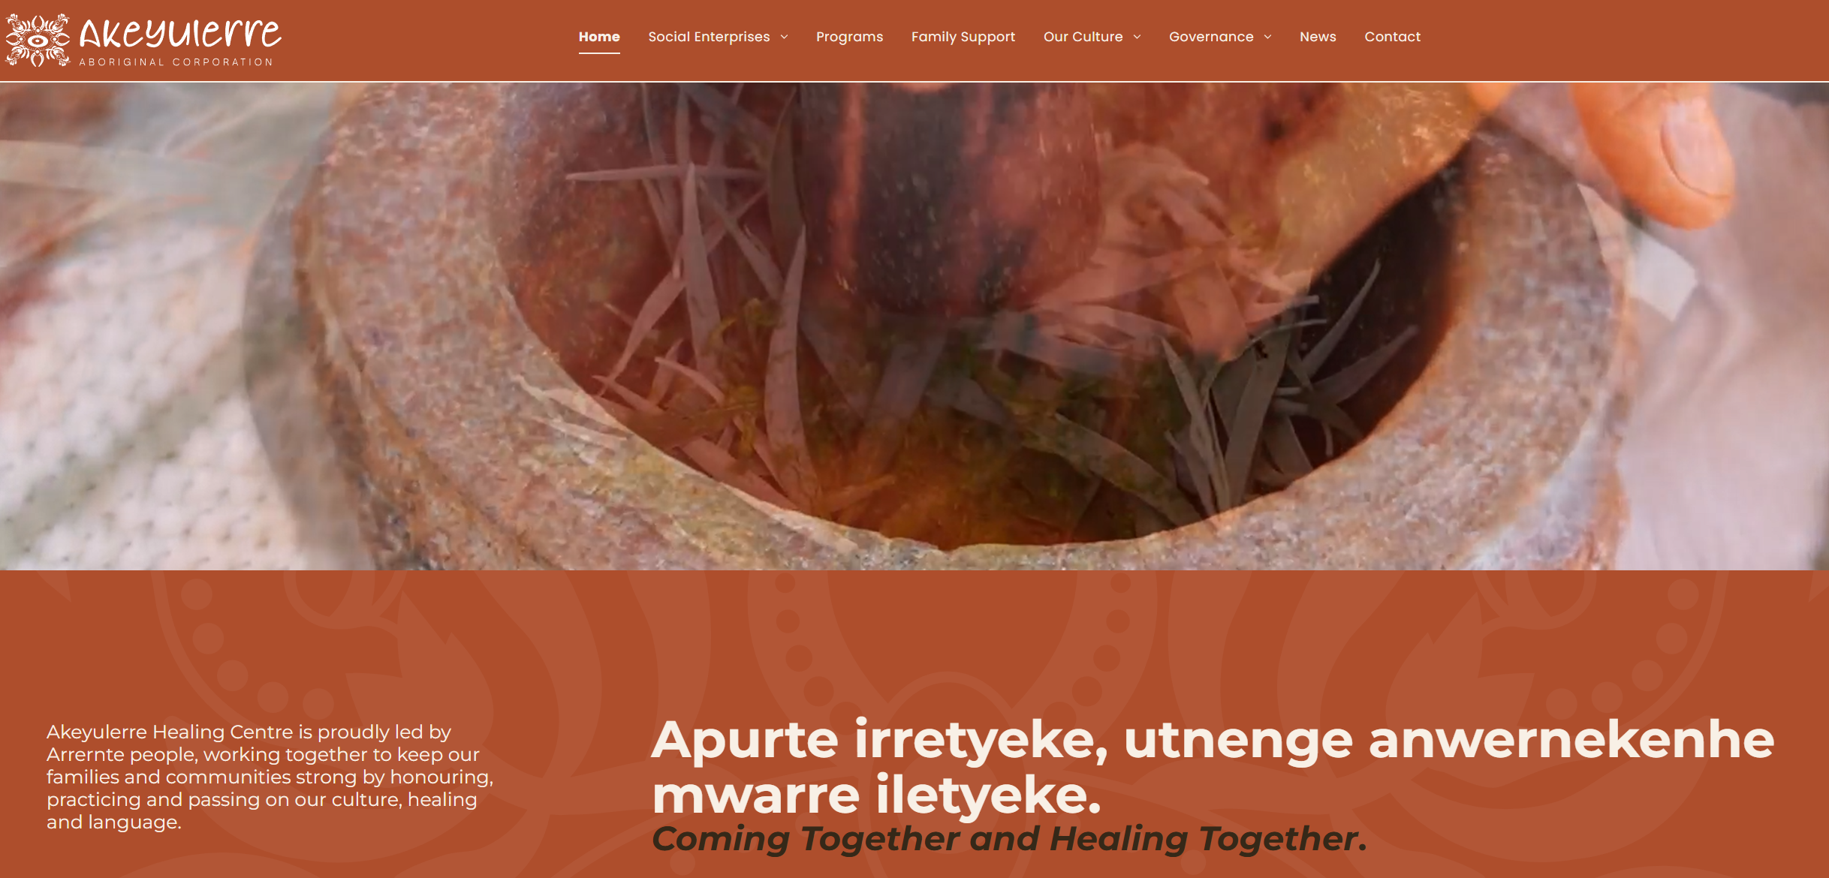
Akeyulerre Healing Centre
Why it matters:
Cultural determinants: Culture, Country, language, kinship, identity.
Strengths‑based practice: Focus on resilience, pride, and cultural continuity.
SEWB: Supports spirit, mind, body, family, community, and Country.
Community governance: Elders lead and decide.
Holistic wellbeing: Culture improves emotional, spiritual, and social health.
Contrast with deficit models: Moves away from “problems” to cultural strengths.
What happens:
Aboriginal Elders created a healing centre in Alice Springs.
Activities include bush medicine making, trips to Country, language teaching, and storytelling.
Families and kin are involved in healing.
Decisions are made by the community (community‑controlled).
Culture is treated as medicine.
https://www.akeyulerre.org.au/

Slide 12
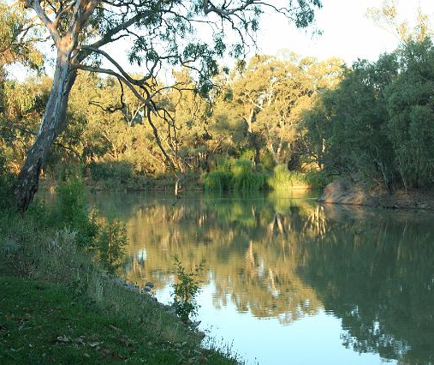
Activity: Listening to Country: Cultural Determinants in Practice
Identify key cultural determinants of health.
Reflect on how these determinants intersect with clinical and community health practice.
Explore culturally safe and responsive approaches to health care.
Collaborate across disciplines to propose culturally safety health strategies.

Slide 13
In groups – either same discipline or mixed discipline fields
Select a ‘Scenario’
Review the Cultural Determinants of Health: Key Concepts Handout
Identify the Cultural determinants in your scenario
Post the Group Reflections and Responses – you can use the discussion prompts (provided) to get the conversation started
Share your findings with the class

Slide 14
The activity showed where we get strength.
Next, we discuss Why they are necessary. Why we need our strengths to support us and our health.
These help us deal with those situations beyond our control, the social determinants, which continually, and cumulatively impact our health and wellbeing

Slide 15
Social Determinants of health (SDoH)
Examples of social determinants of health, which can influence health equity in positive and negative ways:
income and social protection
education
unemployment and job insecurity
working life conditions
food insecurity
housing, basic amenities and the environment
early childhood development
social inclusion and non-discrimination
structural conflict
access to affordable health services of decent quality (WHO 2023 in AIHW, 2024).
https://www.aihw.gov.au/reports/australias-health/social-determinants-of-health

Slide 16
Social Determinants of Health further impacting Aboriginal and Torres Strait Islander peoples (SDoH)
Social determinants of health also impacting Aboriginal and Torres Strait Islander peoples
early childhood development
community and family safety
education and youth
employment and income
racism
housing
environment and infrastructure
interactions with government systems and services
law and justice
poverty
food security
experiences with alcohol, tobacco and other drugs
colonisation and intergenerational trauma
Australian Government, Department of Health, Disability and Ageing, 2021, Status and determinants of Aboriginal and Torres Strait Islander health, Canberra.
https://www.health.gov.au/topics/aboriginal-and-torres-strait-islander-health/status-and-determinants

Slide 17
Recap (Module 2): Racism & Bias
Racism is a stressor that has been reported to affect both mental and physical health.
There is a growing body of literature that validates the public health impact of racial bias, implicit and explicit, on the lives and health of First Nations Peoples.
Stereotyping and negative discourse enable the racism to continue – the construction of understanding Aboriginal peoples “reinforces unequal power relationships; in other words, an image of sick, disorganised communities can be used to justify paternalism and dependency” (Bond & Singh, 2020)

Slide 18

Systemic and Institutional Racism
Braveman et al (2022) shared: “Systemic racism emphasizes the involvement of whole systems, and often all systems—for example, political, legal, economic, health care, school, and criminal justice systems—including the structures that uphold the systems.
Institutional (Structural) racism emphasises the role of the structures (laws, policies, institutional practices, and entrenched norms) that are the systems’ scaffolding.
Image: Iceberg Simon Lee Unsplash

Slide 19
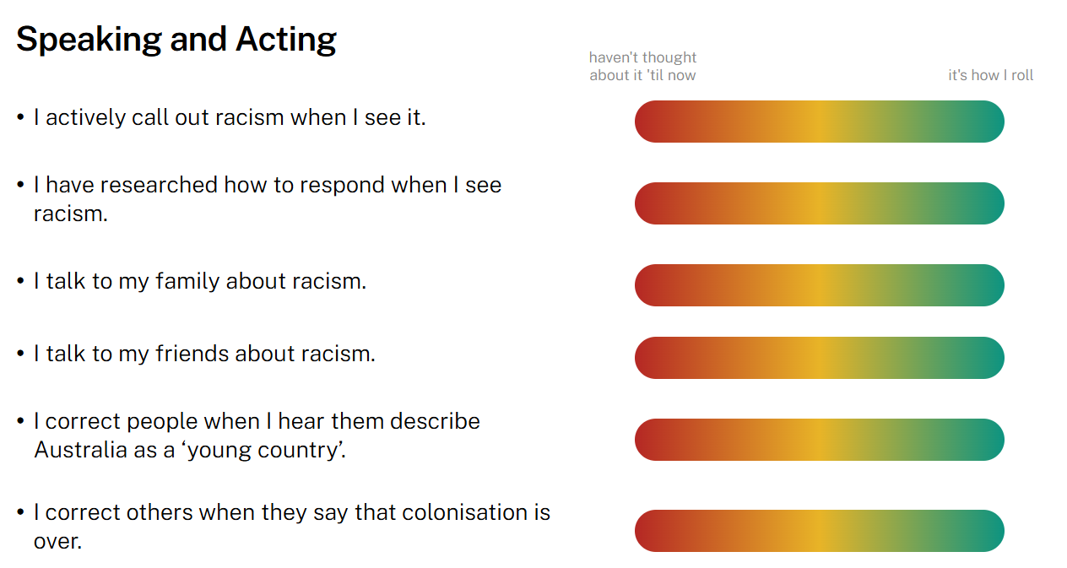
Check Up
What are we doing about racism
Engaged ANU | Ending racism: Check up

Slide 20
Othering
Othering can be seen by actions such as:
thinking that people outside your social/cultural group are not as intelligent or skilled as you and this is then reflected in your actions and tone of language
ignoring people’s ideas or opinions
not giving people the benefit of the doubt
failing to share vital information with others
excluding others

Slide 21

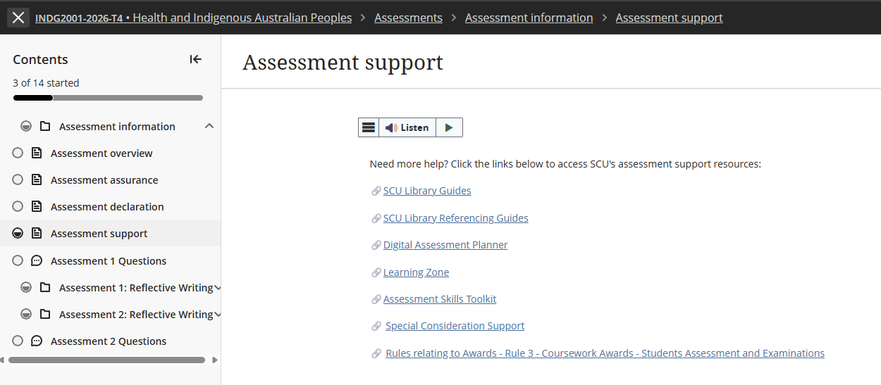
Requesting a Special Consideration Support extension

Slide 22
Assessment 1 – Short Response
Title | Assessment 1
Type | Short response
Length | 1,000 words
Weighting | 40%
Academic Integrity | Level 2. Purpose-Specific GenAI Use GenAI may NOT be used EXCEPT Grammarly Premium AI.
Submission | Word document submitted to Blackboard
Unit Learning Outcomes | This assessment task maps to the following ULOs: ULO1: Discuss key concepts of health and wellbeing as determined by Aboriginal People. ULO2: Identify key stages of the colonisation process and its relationship to the contemporary health status of Australian Indigenous People.

Slide 23
Always use unit approaches (concepts, theories, models, processes or guidelines) in your short responses. Often, this means defining and applying unit concepts or theories.
Before you start working on the assessment, find definitions in the unit materials. This step will help you gain a more detailed grasp of unit ideas and theories so that you can show this understanding to the marker.
Don't try to COVER EVERYTHING you know about a topic. While it can be tempting, this is not your task in a short response, and you don't have enough words. Offer your informed answer to the question within a limited word count.
As you brainstorm, plan, and draft keep trying to narrow, narrow, narrow your focus.
You can use headings in a short response, it is part of the word count.
Overview to Writing a Short Response

Slide 24


10 Key Steps for Strong Short Response Writing
Start with a clear main point: Emphasise that short responses must begin with the answer, not background. Example sentence starters such as: “This concept refers to…” or “In the scenario, this is evident when…”.
2. Explain the key concept briefly: Define or clarify the concept in their own words before applying it. This prevents vague or incorrect use of terms
3. Link the concept to UNDRIP Article 3
Show clearly how the concept relates to the rights described in Article 3 and to Australian Indigenous Peoples understandings of health and wellbeing. Interpret the connection—do not retell general background information.
4. Use scholarly or unit evidence: Short responses still require academic grounding. Evidence can be a unit concept, framework, or scholarly idea. Keep it brief.
5. Write concisely and coherently: Use short, direct sentences - improves clarity and reduces grammatical errors - avoid long introductions, unnecessary detail, or narrative writing.

Slide 25
10 Key Steps for Strong Short Response Writing continued …
6. Maintain respectful terminology: Remember: Correct and consistent use of your chosen term
7. Conclude by linking back to the question: A final sentence should reinforce the main point to close the paragraph logically and signals relevance to the marker.
8. Avoid common pitfalls: Highlight typical issues: over‑description, missing the main point, unclear links to Article 3, lack of evidence, incorrect terminology, and overly long sentences.
9. Use postgraduate verbs: Encourage verbs that show analysis and interpretation: analyse, interpret, examine, integrate, contextualise. Discourage vague verbs like talk about or discuss.
10. Follow a simple structure (PEEL): Point → Explain → Evidence/Scenario → Link.

Slide 26
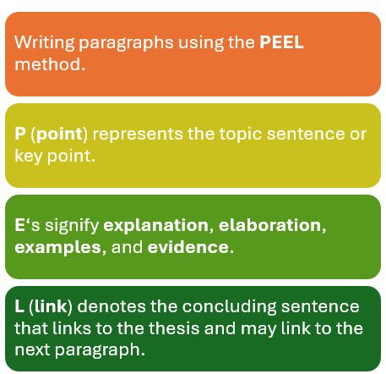
PEEL Writing Structure

Slide 27
Assessment 1 Overview
Purpose of the Assessment
Builds understanding of Australian Indigenous perspectives of health and wellbeing.
Introduces self‑determination as a core principle in UNDRIP Article 3.
Highlights differences between Australian Indigenous wholistic health and Western biomedical models.
Examines how colonisation has limited the ability to exercise self‑determination.
Develops foundational knowledge for culturally safe practice in health, social services, and community work.
Strengthens critical thinking and culturally grounded analysis for professional contexts.
Task Description
Read Article 3 of the United Nations Declaration on the Rights of Indigenous Peoples (UNDRIP):
"Indigenous peoples have the right to self-determination. By virtue of that right, they freely determine their political status and freely pursue their economic, social and cultural development."
Write a 1,000-word short response explaining how this article relates to Australian Indigenous Peoples understandings of health and wellbeing.

Slide 28
Assessment 1 - Instructions
Step 1: Read UNDRIP Article 3
Consider what the term self-determination means and why it is important for Australian Indigenous Peoples.
Step 2: Review Unit Content
Use learning materials from:
  Module 1: Australian Indigenous concepts of health and wellbeing.
  Module 2: Colonisation and its impacts on Australian Indigenous health and wellbeing.
Step 3: Research
Locate additional scholarly literature that supports your discussion.
  Definition of Scholarly and Peer-Reviewed sources
  Peer-reviewed sources are academic publications that have been evaluated by experts before publication to ensure quality, accuracy, and credibility. Scholarly sources are written by researchers or experts for an academic audience and include journal articles, academic books, conference papers, and theses. They typically provide author credentials and references. All peer-reviewed sources are scholarly, but not all scholarly sources are peer-reviewed. For example, an academic book may be scholarly without undergoing peer review.
Step 4: Write Your Response
Your response should explain how Australian Indigenous concepts of health and wellbeing, self-determination, and community-accepted communication styles are interconnected, and how these relate to the ongoing impacts of colonisation on Australian Indigenous health and wellbeing.

Slide 29
Example Short Response Structure
Introduction (Approx. 100 words)
Introduce UNDRIP Article 3.
Outline the main points of your response.
Health and Wellbeing (Approx. 300 words)
Examine the key concepts of health and wellbeing from Australian Indigenous perspectives.
Reflect on why self-determination is important for Australian Indigenous health and wellbeing.
Critically evaluate one cultural determinant which shapes Australian Indigenous health and wellbeing.
Community-accepted communication styles (Approx. 300 words)
Critically analyse the role of community-accepted communication styles in supporting Australian Indigenous health and wellbeing.
Colonisation and Health (Approx. 200 words)
Critically reflect on the enduring effects of colonisation on Australian Indigenous health and wellbeing.
Conclusion (Approx. 100 words)
Summarise your key points. NO new information

Slide 30
Your response must …
Assessment Requirements
Follow the Short Response Quick Guide (Assessment 1 resources).
Address UNDRIP Article 3 throughout your discussion.
Analyse Australian Indigenous concepts of health and wellbeing, including self‑determination and one cultural determinant.
Explain the relationship between colonisation and contemporary Australian Indigenous health outcomes.
Support your discussion with scholarly evidence.
Sources & Referencing
Use a minimum of five (5) scholarly sources.
UNDRIP must be cited and referenced, but does not count toward the five scholarly sources.
Your reference list must contain at least six (6) references in total.

Slide 31
Ensure you meet the following Criteria:
Referencing style of APA7.
Consistent use of correct and appropriate terminology and tone in reference to Indigenous Australian Peoples, communities, and issues.
Use a minimum of 5 peer-reviewed scholarly sources, 1 MUST be the The United Nations Declaration on the Rights of Indigenous Peoples (UNDRIP) 2007.
Wikipedia, Creative Spirits and or other such websites are not acceptable scholarly reference material.
Referencing Requirements

Slide 32
Other Requirements …
Ensure you have attached your signed and correctly completed Coversheet to the front of your assessment document prior to uploading your final submission.
Label your submission with your surname and initials, and the assessment task's name e.g. SmithJ_ShortResponse.docx
You are required to use APA 7th referencing style in this Unit formatting your document, citations, and references
Instead of a Header you MUST add a footer to your submission.
Add your name and task type – i.e. SmithJ_ShortResponse on left margin, your student ID, and have page number on the right margin e.g.

Slide 33
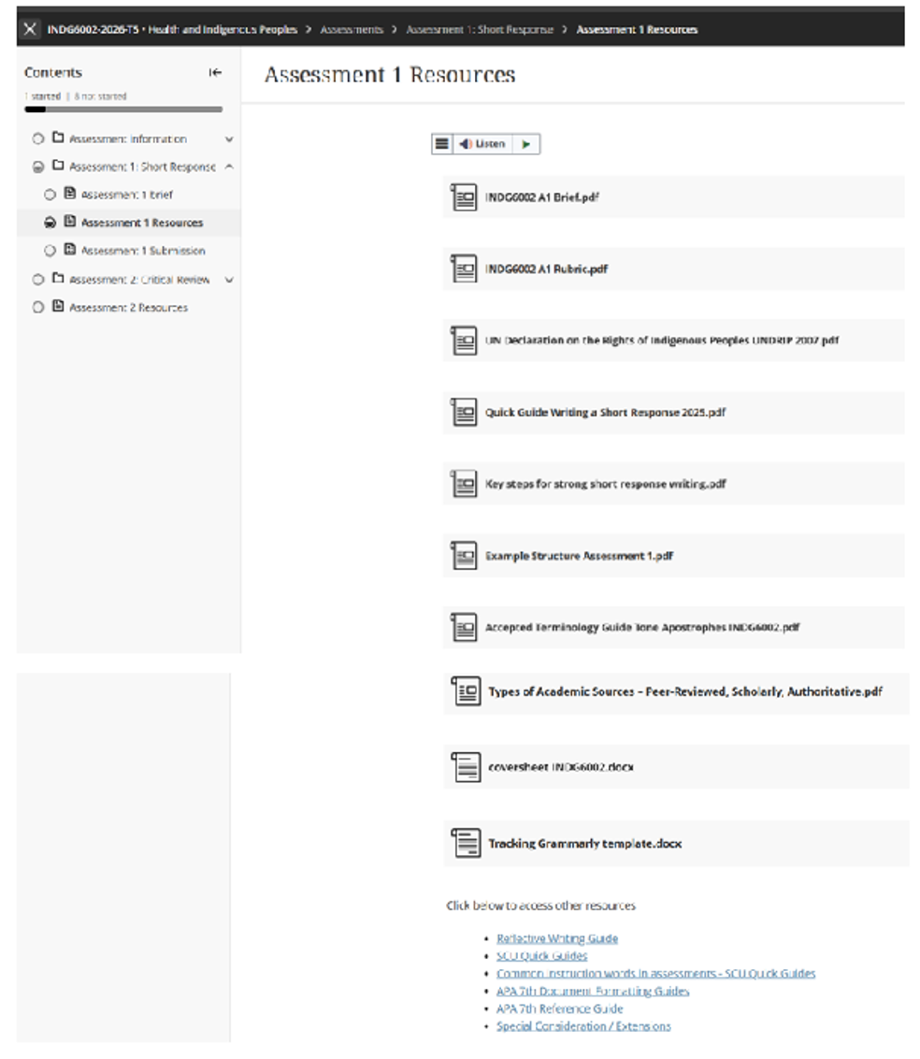
Assessment 1 – Resources & Other Requirements

Slide 34
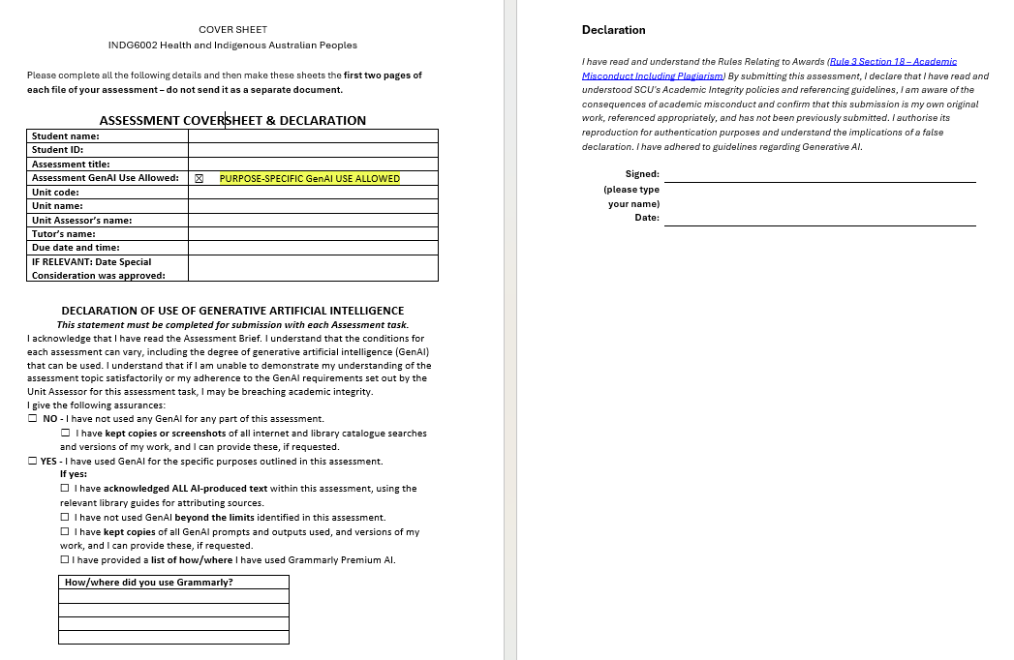
Assessment Coversheet & Declaration

Slide 35
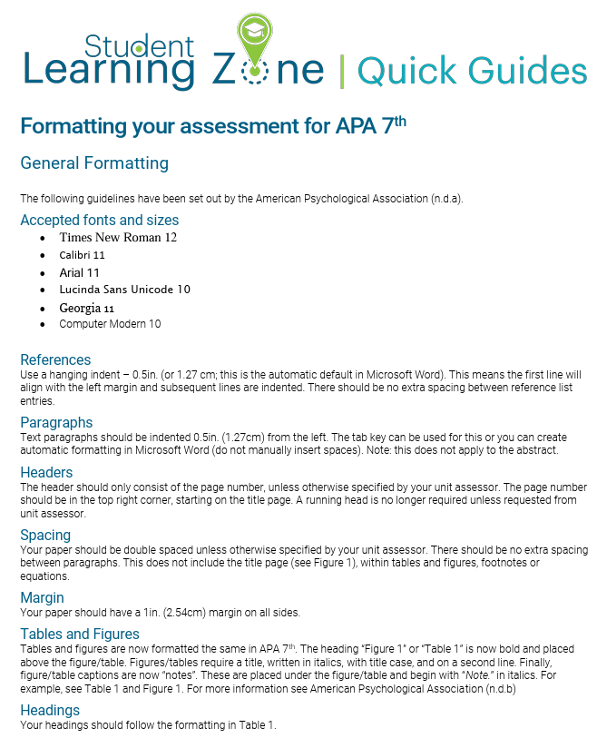
APA 7th Formatting your Document

Slide 36
INDG6002 - GenAI Use
In Gnibi College units, the use of GenAI in assessments is generally restricted to protect the integrity and authenticity of the learning process. Indigenous Knowledges are grounded in lived experience, cultural practices, and relational ways of knowing. Engaging meaningfully with these knowledges requires personal reflection, respectful interpretation, and a commitment to culturally responsive learning—something that cannot be authentically achieved through AI-generated content.

Slide 37
INDG6002 - GenAI Use continued …
This assessment is classified as:
Level 2: AI use permitted for specific purposes. You can use AI for specific tasks as identified by the Unit Assessor.
✅ You may use GenAI to:
Formatting, spelling and grammar - Grammarly Premium AI is permitted for formatting, spelling and grammar. Grammarly is permitted for language improvements – no content or knowledge creation is permitted.
Paraphrasing permitted - Use of Grammarly Premium AI is permitted for paraphrasing. Pay careful attention to any language adjustments that may affect the clarity of your work. Paraphrasing using Grammarly Premium AI must be referenced.
❌ You may not use GenAI to:
Use of any other GenAI for content or knowledge creation is not within the permitted uses for this task.
Present GenAI-generated material as your own original ideas
Ask GenAI to write any part of the analysis, commentary, or conclusions about your chosen study.
Upload or provide text from the research article or for GenAI to rewrite, summarise, or interpret the article.

Slide 38
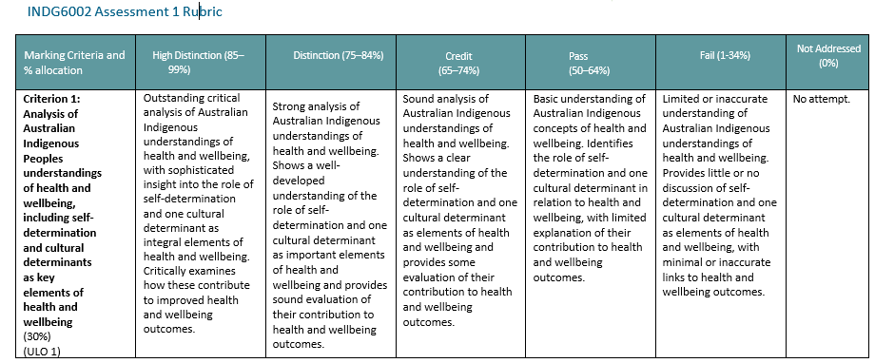
Rubric Assessment 1: Criterion 1

Slide 39
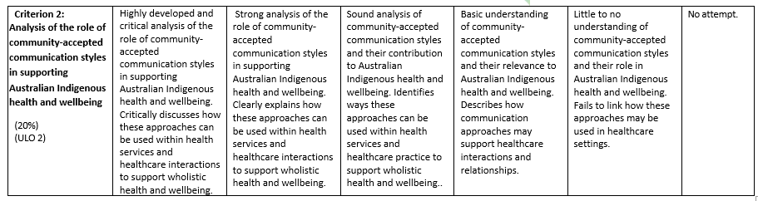
Rubric Assessment 1: Criterion 2

Slide 40
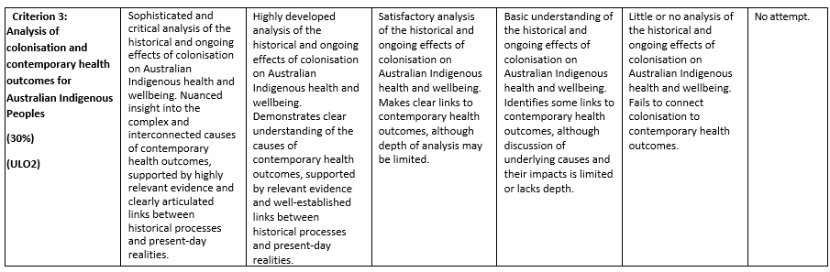
Rubric Assessment 1: Criterion 3

Slide 41
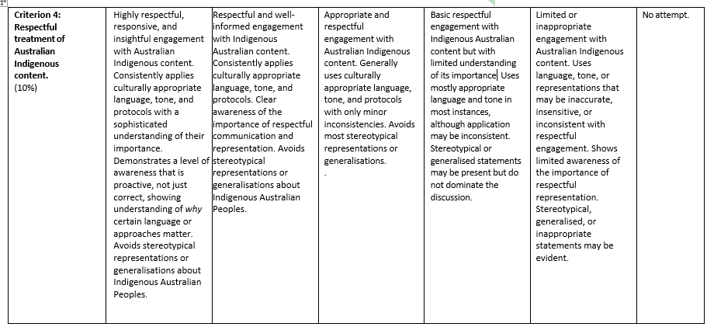
Rubric Assessment 1: Criterion 4

Slide 42
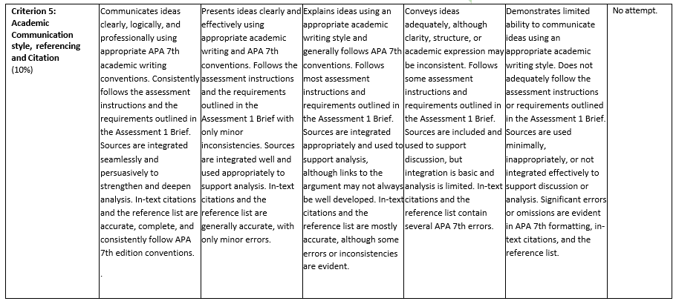
Rubric Assessment 1: Criterion 5

Slide 43

Questions?

Slide 44

Next week

Slide 45

Until Next Time

